Slide 1
Mixed effects modeling
What, Why, and How
Rosemary Hartman

Slide 2


Slide 3

Experimental design
1
4
7
10
Five fish per cage
Three types of cage
Four replicates per type of cage
12 total cages
2
5
8
11
3
6
9
12

Slide 4
Pop quiz – What is the experimental unit?
The fish?
The type of cage?
The cage?
Notes:
The cage is our experimental unit because the fish within a cage are not independent from each other.

Slide 5
Assumptions of a linear model
Independence of observations
Homoskedacity of variance
Normality of residuals
Notes:
Mixed models will help us address the independence of observation assumption. Things that make observations non-independent can be accounted for with random effects.

Slide 6
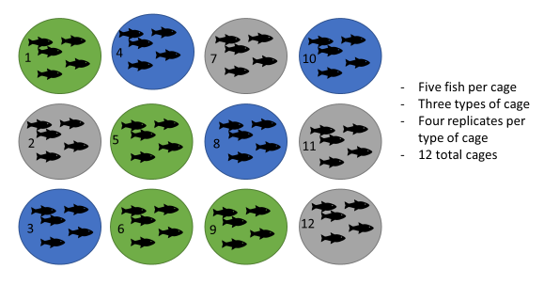
Model structure
Fixed effects – components that are under your control
Random effects – components that impact your results, but aren’t under your control
Notes:
Additionally, the data for our random effect is just a sample of all the possibilities: with unlimited time and funding we might have sampled every cage possible, every school in the country, every chocolate in the box), but we usually tend to generalise results to a whole population based on representative sampling. We don’t care about estimating how much better pupils in school A have done compared to pupils in school B, but we know that their respective teachers might be a reason why their scores would be different, and we’d like to know how much variation is attributable to this when we predict scores for pupils in school Z. For the fish, we don’t really care whether cage 1 is better than cage 2, but we need to know what the cage effect is.

Slide 7
Model structure – three options
mean(Length_{cage}) ~ CageType
Length ~ CageType + Cage
Length ~ CageType + (1|Cage)
Notes:
The fish within a cage aren’t independent, so we can’t treat the fish as independent replicates. We can average all the fish within a cage, but we miss out on a lot of information about variation between fish that way. We can use cage as a fixed effect, but that will make our output messy and use up degrees of freedom. A random effect of cage allows us to account for fish variation without sucking up all our degrees of freedom.
I’ve added a random intercept of cage here.

Slide 8
Random slopes, random intercepts
Length ~ CageType + (1|Cage)
Length ~ CageType + (1+ CageType|Cage)
Notes:
Random intercepts are the norm
Random slopes is basically in interaction between your fixed and random effects.

Slide 9
Nested design
Length ~ CageType + (1|Cage/fish)
1
4
7
10
Measurements taken at the start, middle, and end for each fish
Five fish per cage
Three types of cage
Four replicates per type of cage
12 total cages
2
5
8
11
3
6
9
12
Notes:
Multiple observations per fish are not independent. Multiple fish per cage are not independent. But the individual fish only exists in one cage. This is a nested design. If we had multiple species per cage, but the same species in each cage, then it would be a crossed design.

Slide 10
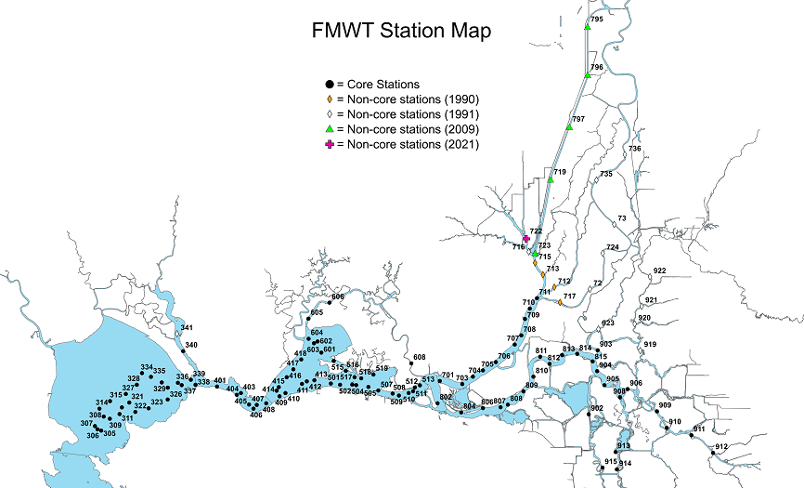
Sampling design
Notes:
We didn’t design the fall midwater trawl, so it’s a bit harder to think about what “is in our control”. Nothing is in our control.

Slide 11
Model Structure
Fixed effects – components that you care about
Random effects – components that impact your results, but you don’t care about
Notes:
Instead, we think about what components we care about for answering our questions and which we need to account for, but we aren’t interested in.

Slide 12
Note on random effects
Random effects should have at least five levels.
Random effects must be categories/groups, not continuous
Which of these are appropriate random effects for the FMWT data?
Day of year
Salinity
Region of the estuary (San Pablo, Suisun Delta)
Station
Month of year
Year
Notes:
This is, put simply, because estimating variance on few data points is very imprecise. Mathematically you could, but you wouldn’t have a lot of confidence in it. If you only have two or three levels, the model will struggle to partition the variance - it will give you an output, but not necessarily one you can trust.
Salinity and region should definitely be fixed. Probably day or year too.
Station should definitely be randome (too many levels to be useful as a fixed effect).
Month of year and year could be fixed or random, depending on our question.

Slide 13
Model Structure
Fish ~ Month + Year + (1|Station)
Fish ~ Salinity+ Temperature+ (1|Year) + (1|Month) + (1|Station)

Slide 14
Why bother?
Explore data
Quantifying the variability of the data
Determine how variability affects data interpretation.
Interpret data
Test hypotheses
Notes:
So, we can test hypotheses without doing the fancy mixed model, just average the group and run the test, however that doesn’t accomplish the first goal of quantifying the variability and describing how the variability affects the output.

Slide 15
Further Reading
https://ourcodingclub.github.io/tutorials/mixed-models/#six
https://en.wikipedia.org/wiki/Mixed_model
Zuur AF, Ieno EN, Walker NJ, Saveliev AA, Smith GM. 2009. Mixed Effects Models and Extensions in Ecology with R. New York, NY: Springer.

